Slide 1
MODELLING GENE-DISEASE ASSOCIATIONS AND PREDICTING DRUG SENSITIVITY FOR SCHIZOPHRENIA COPY NUMBER VARIATIONS
Midterm presentation
Pierre Klemmer
22/01/24

Slide 2
BACKGROUND
Etiology of schizophrenia (SCZ) is unclear
Challenges in finding effective treatment
Efficacy of treatment influenced by patient genotype
Two-hit hypothesis for SCZ development
Genetic predisposition / prenatal or early life immunological insults
Insult in in adolescence or post-adolescence
⇒ Schizophrenia development
Guerrin et al. (2021)
Luykx et al. (2023)
Notes:
https://www.sciencedirect.com/science/article/pii/S014976342100467X

Slide 3
RISK FACTORS
Genetic
Relative affected by SCZ
Copy number variations (CNVs)
SNPs in genes linked to neuronal development and the MHC region
Environmental
Exposure to heavy metals
Infections
Obstetric insults
Prenatal nutritional deficiency
Drug abuse
Socioeconomic status
Gejman et al. (2010)
Brown (2011)
Notes:
https://www.ncbi.nlm.nih.gov/pmc/articles/PMC2826121/
https://www.ncbi.nlm.nih.gov/pmc/articles/PMC3521525/

Slide 4
GOALS
Compile schizophrenia risk genes from various sources to get overview of involved genes and processes
Automatic creation of curated supernetwork
Make associations between risk genes and toxicology
Which SCZ risk genes interact with which toxicants?
Which toxicants are especially strong predictors for SCZ development?
Predict drug effects
How is the metabolism of drugs affected by genes contributing to SCZ development?
Based on genotype, which patients benefit most from which drugs?

Slide 5
GOALS
Compile schizophrenia risk genes from various sources to get overview of involved genes and processes
Automatic creation of curated supernetwork
Make associations between risk genes and toxicology
Which SCZ risk genes interact with which toxicants?
Which toxicants are especially strong predictors for SCZ development?
Predict drug effects
How is the metabolism of drugs affected by genes contributing to SCZ development?
Based on genotype, which patients benefit most from which drugs?

Slide 6
SUPERNETWORK - SOURCES
DisGeNET
Query: ‘Schizophrenia’ keyword
Information from curated databases only (UniProt, PsyGeNET, Orphanet, the CGI, CTD (human data), ClinGen, Genomics England PanelApp)
No text mining
Result: 1031 nodes within 1 network
WikiPathways
Query:’Schizophrenia’ keyword + manually selected pathways
Result: 1717 nodes within 22 networks
Publication - Trubetskoy et al. (2022)
GWAS study on 320k participants (24% diagnosed with SCZ)
Result: 120 nodes within 1 network
Each node shows the source it was imported from as property

Slide 7
SUPERNETWORK - MAJOR STEPS
Import and merge source networks to supernetwork
Filter supernetwork
STRINGify supernetwork
Cluster supernetwork
Overrepresentation analysis
Visualisation

Slide 8
SUPERNETWORK - SCRIPT BASICS
R 4.3.2 script
‘RCy3’ package essential for communication between R and Cytoscape
Metadata file generation
Date and time
Cytoscape (+apps) version, R (+packages) version
Query parameters for DisGeNET and WikiPathways
Literature doi
Clustering results
Session-based script structure

Slide 9
SUPERNETWORK - DIRECTORY STRUCTURE
Master directory
Output
Query parameters
Temp CSVs
Session 19/12/23-14h55
Session 18/12/23-16h47
Networks
Metadata
sessioninfo
Supernetwork
Filtered supernetwork
Filtered STRING supernetwork
etc.

Slide 10
SUPERNETWORK - MAJOR STEPS
Import and merge source networks to supernetwork
Filter supernetwork
Remove deprecated nodes like WikiPathways anchors
NAll nodes = 2369
NAll nodes = 2019
Cluster supernetwork
Based on protein-protein interactions
NAll nodes = 3019
NGene nodes = 2628
STRINGify supernetwork
Also expand with 1000 genes from STRING
NGene nodes = 2628
NClusters = 563
Get ‘valid’ clusters and discard rest
Clusters composed of five or more nodes
NGene nodes = 2055
NClusters = 24
Overrepresentation analysis
g:GOSt, entire genome as background
Visualisation

Slide 11
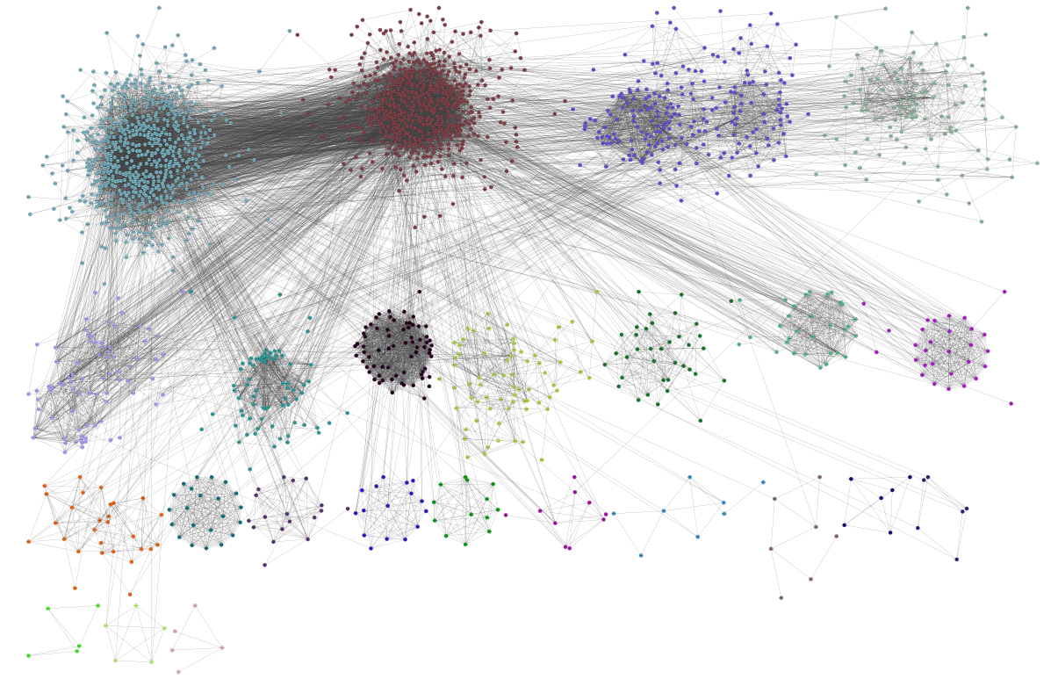
SUPERNETWORK VIEW
2055 nodes
SCZ risk genes
14266 edges
Protein-protein interactions (ppi)
24 clusters
Based on ppi

Slide 12
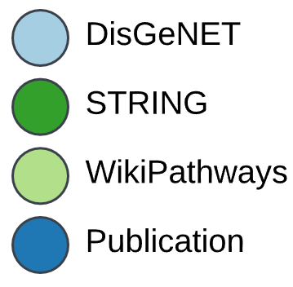
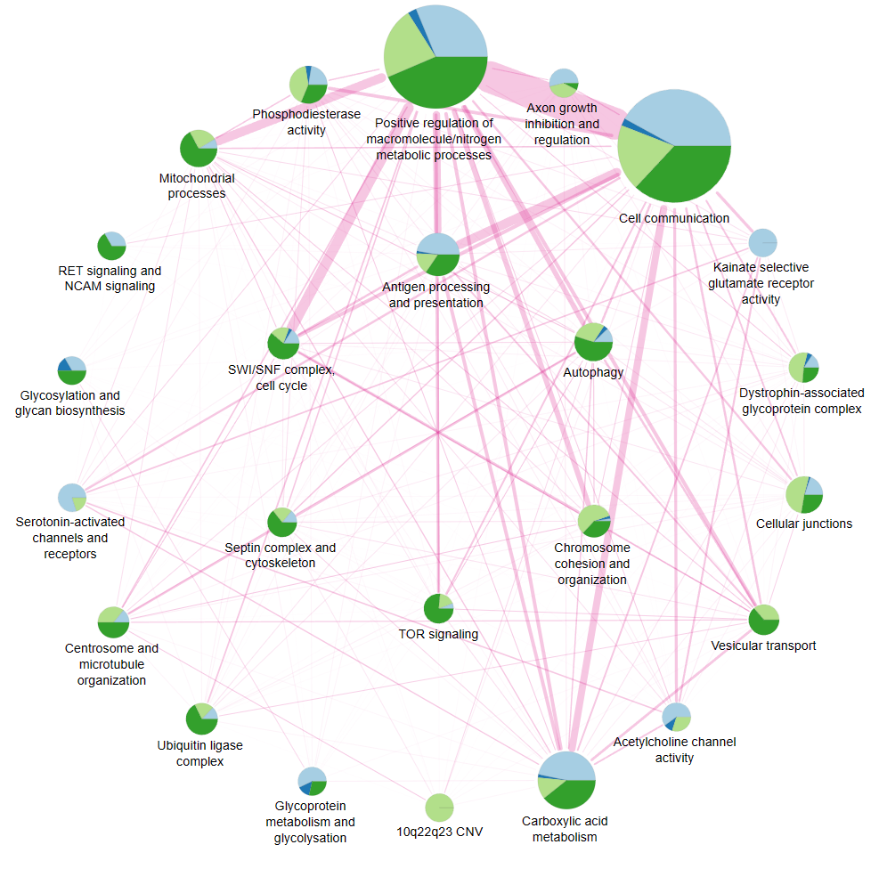
SUPERNETWORK
FUNCTIONAL ANALYSIS
Nodes / pie charts
Represent valid clusters
Labels are manually selected gene ontology terms
Size relative to number of nodes in cluster
Sections relative to proportion of node sources in cluster
Edges
Number of shared gene ontology terms

Slide 13
GOALS
Compile schizophrenia risk genes from various sources to get overview of involved genes and processes
Automatic creation of curated supernetwork
Make associations between risk genes and toxicology
Which SCZ risk genes interact with which toxicants?
Which toxicants are especially strong predictors for SCZ development?
Predict drug effects
How is the metabolism of drugs affected by genes contributing to SCZ development?
Based on genotype, which patients benefit most from which drugs?

Slide 14
BACKGROUND
Etiology of schizophrenia (SCZ) is unclear
Challenges in finding effective treatment
Efficacy of treatment influenced by patient genotype
Two-hit hypothesis for SCZ development
Genetic predisposition / prenatal or early life immunological insults
Insult in in adolescence or post-adolescence
⇒ Schizophrenia development
Guerrin et al. (2021)
Luykx et al. (2023)
Notes:
https://www.sciencedirect.com/science/article/pii/S014976342100467X

Slide 15
RISK FACTORS
Genetic
Relative affected by SCZ
Copy number variations (CNVs)
SNPs in genes linked to neuronal development and the MHC region
Environmental
Exposure to heavy metals
Infections
Obstetric insults
Prenatal nutritional deficiency
Drug abuse
Socioeconomic status
Gejman et al. (2010)
Brown (2011)
Notes:
https://www.ncbi.nlm.nih.gov/pmc/articles/PMC2826121/
https://www.ncbi.nlm.nih.gov/pmc/articles/PMC3521525/

Slide 16
ADVERSE OUTCOME PATHWAYS (AOPs)
Stressor
Key event relationship
Molecular initiating event
Key event
Key event
Adverse outcome
Infection
Drug abuse
Disruption of neural development
Psychosis
Schizophrenia
Genetic predisposition

Slide 17
AOP-Wiki
AOP = Adverse outcome pathway
AO = adverse outcome
Supernetwork
AOP-Wiki
AOP 113
AO 82
Gene A
Key event 187
Lead
Gene C
Gene B
Key event 26
Gene B
Alcohol
Gene D
Gene A

Slide 18
AOP-Wiki
AOP = Adverse outcome pathway
AO = adverse outcome
Supernetwork (SNW)
AOP-Wiki
AOP-extended SNW
Lead
Gene A
Key event 26
AO 82
AOP 113
Extend selected risk genes in supernetwork with key events, AOs, AOPs, and stressors
Establish pathway from risk gene to disease
Make association between chemical and gene/disease

Slide 19

AOP EXTENSION - MAJOR STEPS I
AOP = Adverse outcome pathway
AO = adverse outcome
KER = Key-event relationship
KE = Key event
Database
AOP-Wiki SPARQL endpoint
Query
Get list of all AOs in AOP-Wiki
Selection
Manually select AOs for neuronal/psychiatric outcomes
Get URIs of KERs and KEs associated with AOPs containing selected AOs
Query
Outcome
List of “selected KEs”
Import selected KEs as network
“Selected KEs” network

Slide 20
AOP EXTENSION - MAJOR STEPS II
AOP = Adverse outcome pathway
AO = adverse outcome
KER = Key-event relationship
KE = Key event
Database
AOP-Wiki SPARQL endpoint
Query
Get list of all KE URIs and associated Ensembl gene IDs
Selection
Remove KEs not found in “selected KEs” list and genes associated with them
Import remaining KEs and associated genes as network
KE and gene network

Slide 21
AOP EXTENSION - MAJOR STEPS III
AOP = Adverse outcome pathway
AO = adverse outcome
KER = Key-event relationship
KE = Key event
“Selected KEs” network
KE and gene network
KE network
Gene Y
Key event 23
Gene C
Key event 23
Key event
46
Key event
46
Key event
46
Key event 55
Gene A
Gene B
Gene Y
Key event 55
Gene C
Key event 31
Key event 31
Key event 31
Gene A
Gene B
Extend selected KEs based on selected AOs with available genes

Slide 22
AOP EXTENSION - MAJOR STEPS IV
AOP = Adverse outcome pathway
AO = adverse outcome
KER = Key-event relationship
KE = Key event
KE network
Supernetwork
KE-extended supernetwork
Key event
46
Gene Y
Gene Y
Key event 23
Key event 31
Gene A
Key event
46
Gene A
Gene A
Gene C
Gene C
Gene C
Key event 55
Gene C
Gene C
Gene B
Gene B
Key event 31
Gene B
Gene D
Gene D
Gene B
Gene E
Gene A
Gene B
Gene E
Gene A
Gene F
Gene F

Slide 23
AOP EXTENSION - MAJOR STEPS IV
AOP = Adverse outcome pathway
AO = adverse outcome
KER = Key-event relationship
KE = Key event
Some considerations for merging and filtering
No new genes should be introduced to the supernetwork; only extend existing genes with AOP data
Therefore: Delete gene nodes in extended supernetwork that only have AOP-Wiki as source
Indicates that they are newly added
Only keep KEs associated with gene nodes
Should remove KEs associated to new genes
Keep KEs associated with KEs directly linked to existing gene (first neighbor)
“Valid KEs”

Slide 24
AOP EXTENSION - MAJOR STEPS V
AOP = Adverse outcome pathway
AO = adverse outcome
KER = Key-event relationship
KE = Key event
Database
AOP-Wiki SPARQL endpoint
Query
Get list of AOPs and AOs associated with “valid KEs”
Import AOPs with associated “valid KEs”
Import AO with AOPs
“Valid KEs” extended with associated AOs and AOPs
AOP network

Slide 25
AOP EXTENSION - MAJOR STEPS V
AOP = Adverse outcome pathway
AO = adverse outcome
KER = Key-event relationship
KE = Key event
KE -extended supernetwork
AOP network
AOP-extended supernetwork
AO 14
AOP 66
Key event
46
Key event
46
AOP 66
Key event 31
Gene A
Key event
46
Key event 31
Gene A
Gene C
AO 14
Key event
31
Gene C
Gene B
AOP 24
Gene B
AO 18
Gene D
AO 18
Gene D
Gene E
Gene E
Gene F
AOP 24
Gene F

Slide 26
AOP EXTENSION OUTCOME
AOP-extended supernetwork
14512 edges
2165 total nodes
2055 gene nodes
110 AOP-Wiki nodes
59 AO or KE nodes
51 AOP nodes
No visualisation yet
No analysis yet
Next: Extend with chemicals from AOP-Wiki

Slide 27
FEEDBACK
Difficult to show process of AOP network construction
Many steps run in parallel; some depend on outcomes of previous/simultaneous steps
Flow charts for thesis text

Slide 28
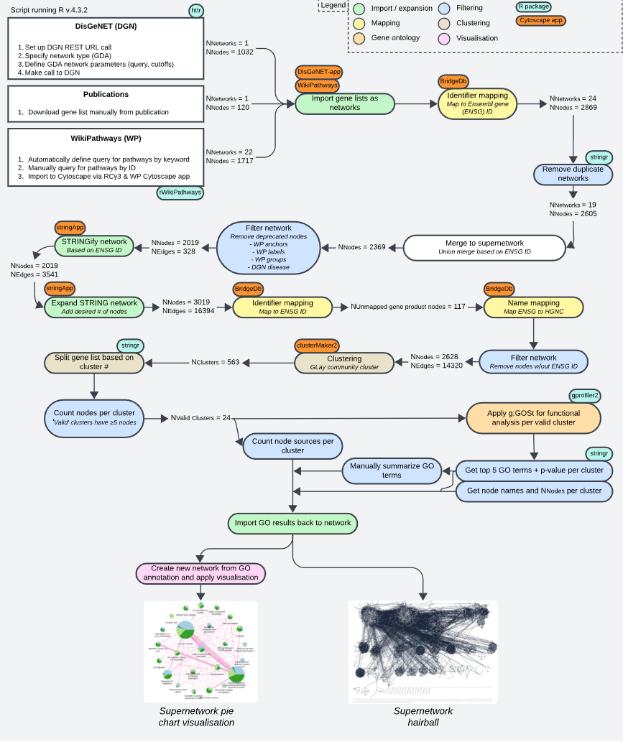

Slide 29
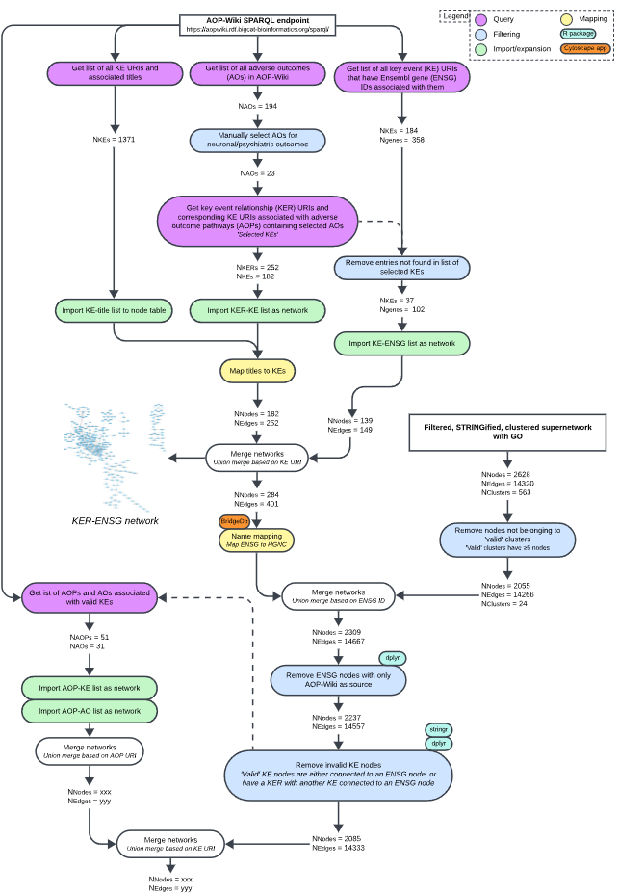

Slide 30
FEEDBACK
Uncertain about filtering logic when merging supernetwork and AOP network (slide 23)
Do not want to introduce new genes to supernetwork from AOP-Wiki
Simply extend existing genes with KEs, AOs, AOPs, stressors
Uncertain about validity of information in network
Limited by database curation status (e.g. many KEs from AOP-Wiki have few or no genes)
Level of evidence differs by source
Schizophrenia as a symptom of another disease, not a disease by itself
Changes interpretation of results
External validity of project
How can I check if my results make sense?

